Slide 2
Understanding Deep Copy, Shallow Copy, and No Copy in C++
Introduction
In C++, object copying can be done in three main ways: No Copy, Shallow Copy, and Deep Copy.
Understanding the differences is crucial for memory management and data integrity.
Let's explore each method with examples.

Slide 3
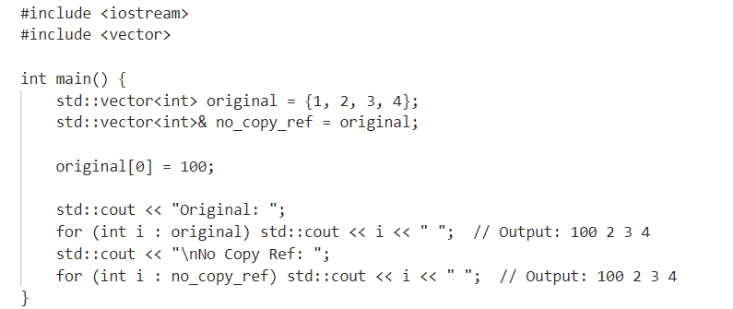
No Copy
No copy means using the original object directly without creating any duplicate.
Useful when multiple references to the same object are needed.

Slide 4
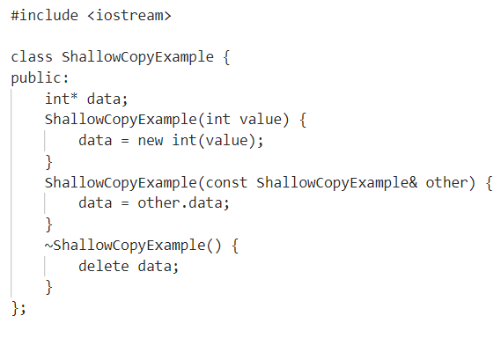
Shallow Copy
Shallow copy duplicates the object but not the objects contained within it.
Both the original and the copied object share the same references.

Slide 5
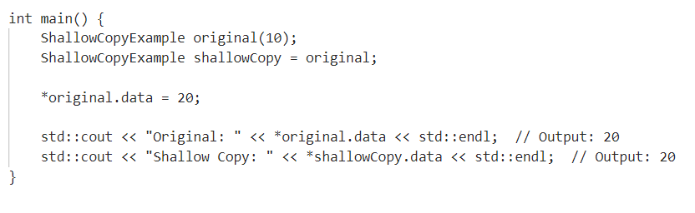
Shallow Copy

Slide 6
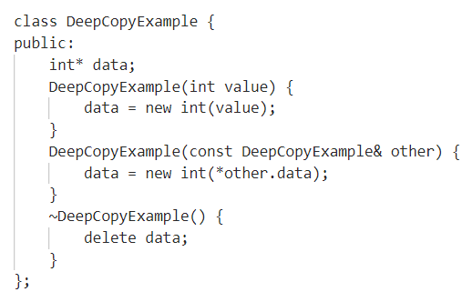
Deep Copy
Deep copy duplicates the object as well as all objects contained within it.
Ensures the original and copied objects are completely independent.

Slide 7
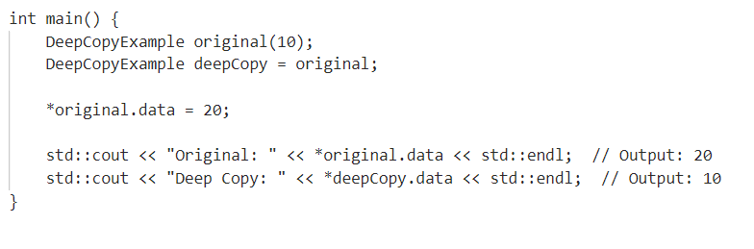
Deep Copy

Slide 8
When to Use No Copy
Use No Copy when multiple parts of a program need to access the same object.
Reduces memory usage and overhead of copying.
Suitable for read-only data or when modifications are synchronized.
When to Use Shallow Copy
Use Shallow Copy for simple structures where nested objects do not require independent changes.
Faster and consumes less memory compared to deep copying.
Be cautious of unintended side effects due to shared references.

Slide 9
When to Use Deep Copy
Use Deep Copy when working with complex structures needing complete independence.
Ensures data integrity and prevents side effects from shared references.
Suitable for objects with dynamic memory allocation or deep nesting.

